Slide 1
Modeling Dependent Effect Sizes in Meta-analysis: Comparing Two Approaches
Fred Oswald, Chen Zuo, & Evan S. Mulfinger Rice University

Slide 2
Intelligently summarize research findings
Locate all research within a given domain; screen for relevance (e.g., err on the side of inclusiveness)
Attempt to correct research findings for known sources of bias: (e.g., various sources of range restriction, measurement error variance)
Weight findings by the information provided (e.g., larger N and less correction in #2 = more information)
After the correction and weighting, report the overall mean and variance of the effects (Oswald & McCloy, 2003)
Examine subgroups (moderators): what fixed effects predict random effects variance?

Slide 3
Intelligently summarize research findings
Locate all research within a given domain; screen for relevance (e.g., err on the side of inclusiveness)
Attempt to correct research findings for known sources of bias: (e.g., various sources of range restriction, measurement error variance)
Weight findings by the information provided (e.g., larger N and less correction in #2 = more information)
After the correction and weighting, report the overall mean and variance of the effects (Oswald & McCloy, 2003)
Examine subgroups (moderators): what fixed effects predict random effects variance?

Slide 4
Intelligently summarize research findings
Locate all research within a given domain; screen for relevance (e.g., err on the side of inclusiveness)
Attempt to correct research findings for known sources of bias: (e.g., various sources of range restriction, measurement error variance)
Weight findings by the information provided (e.g., larger N and less correction in #2 = more information)
After the correction and weighting, report the overall mean and variance of the effects (Oswald & McCloy, 2003)
Examine subgroups (moderators): what fixed effects predict random effects variance?

Slide 5
Intelligently summarize research findings
Locate all research within a given domain; screen for relevance (e.g., err on the side of inclusiveness)
Attempt to correct research findings for known sources of bias: (e.g., various sources of range restriction, measurement error variance)
Weight findings by the information provided (e.g., larger N and less correction in #2 = more information)
After the correction and weighting, report the overall mean and variance of the effects (Oswald & McCloy, 2003)
Examine subgroups (moderators): what fixed effects predict random effects variance?

Slide 6
Intelligently summarize research findings
Locate all research within a given domain; screen for relevance (e.g., err on the side of inclusiveness)
Attempt to correct research findings for known sources of bias: (e.g., various sources of range restriction, measurement error variance)
Weight findings by the information provided (e.g., larger N and less correction in #2 = more information)
After the correction and weighting, report the overall mean and variance of the effects (Oswald & McCloy, 2003)
Examine subgroups (moderators): what fixed effects predict random effects variance?

Slide 7
Intelligently summarize research findings
Locate all research within a given domain; screen for relevance (e.g., err on the side of inclusiveness)
Attempt to correct research findings for known sources of bias: (e.g., various sources of range restriction, measurement error variance, dependent effect sizes)
Weight findings by the information provided (e.g., larger N and less correction in #2 = more information)
After the correction and weighting, report the overall mean and variance of the effects (Oswald & McCloy, 2003)
Examine subgroups (moderators): what fixed effects predict random effects variance?

Slide 8
Dependent effect sizes: What are they?
Three types of dependence (Cheung, 2015):
Sample dependence – effects arise from the same sample [even r(X,Y) and r(Z,Q) are correlated in the same sample]
Effect-size dependence – effects based on the same or related constructs [this is tau aka SDrho across studies measuring the same effect; but here we’re talking about effects within studies]
Nested dependence – effects may come from the same study, the same organization, but the exact nature of nesting is unknown

Slide 9
Handling dependent effects: Old school
Take the average and enter it with its cumulative N, (e.g., 2 studies out of 100). Heterogeneity gets ignored.
Treat them as if they were independent (e.g., 2 studies out of 100). Dependency gets ignored.
Keep one of the effects (randomly, based on some rule) and drop the rest. Some effects get ignored.
Separate the effects using subgroups (moderators). Dependency still exists across levels, but gets ignored.

Slide 10
…What if there are a lot of dependent effects?: New school
Take a not-refined-but-parsimonious approach:
Robust meta-analysis If total dependency = 1 and complete independence = 0, specify all dependent effects as something in between, like .80 (.80 is the default, value doesn’t matter in a wide range of cases) (Fisher & Tipton, 2014; Hedges, Tipton, & Johnson, 2010)
Multilevel meta-analysis Dependence cannot be estimated accurately from the data, but there is known clustering; e.g., effects from the same site; multiple comparisons against a control group (see Konstantopolous, 2011)

Slide 11
…What if there are a lot of dependent effects?: New school
Take a not-refined-but-parsimonious approach:
Robust meta-analysis If total dependency = 1 and complete independence = 0, specify all dependent effects as something in between, like .80 (.80 is the default, value doesn’t matter in a wide range of cases) (Fisher & Tipton, 2014; Hedges, Tipton, & Johnson, 2010)
Multilevel meta-analysis Dependence cannot be estimated accurately from the data, but there is known clustering; e.g., effects from the same site; multiple comparisons against a control group (see Konstantopolous, 2011)

Slide 12
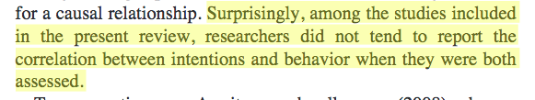
Handling dependent effects: New school
Take the more-refined-yet-most-complex approach: Account for the level of sample dependency (e.g., have all correlations), even samples/settings vary in unknown ways, and N may be small (Cheung, 2014; Hedges & Olkin, 1985; Rosenthal & Rubin, 1986)
We were hoping to do this ☹ - more studies should report all correlations for the purposes of improved meta-analyses

Slide 13
R code examples:
We focus on simpler MA modeling of dependence, applying (a) multilevel modeling and (b) robust MA, to 2 data sets:
Ferguson and Brannick (2002) provide published vs. unpublished effect sizes (converted to z’ scores) across 24 meta-analyses.
Sweeney (2015) examine 10 studies that provided effect sizes related to intentions vs. effect sizes related to behaviors

Slide 14
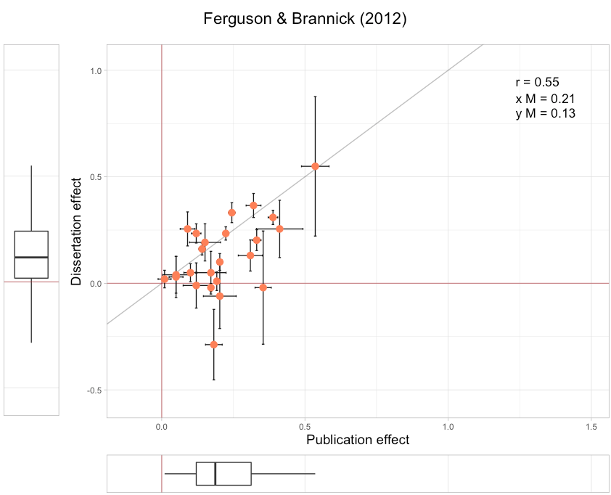
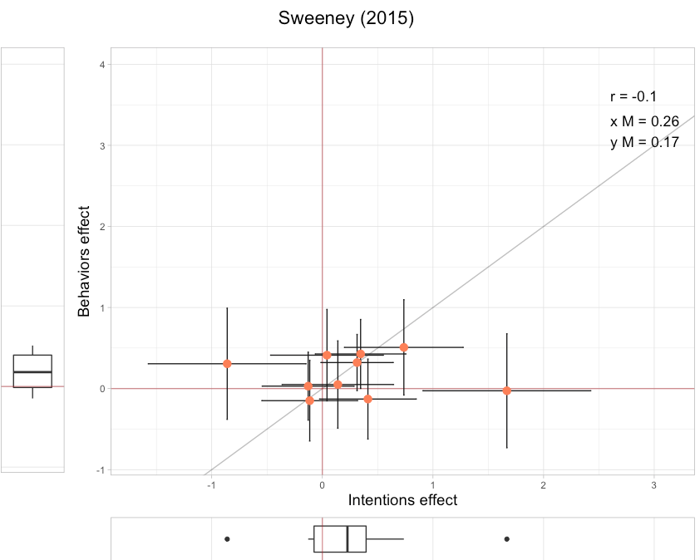
Cool plots: metaplotr (Brannick & Gültas, 2017)

Slide 15
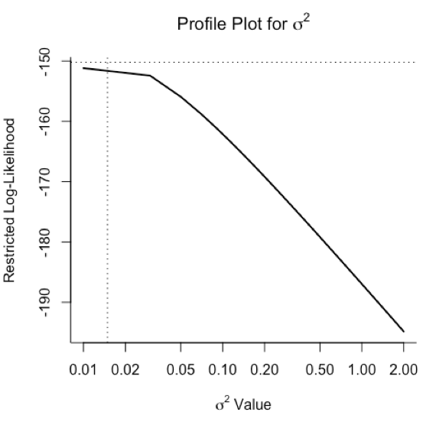
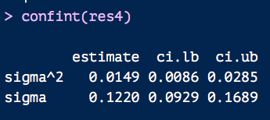
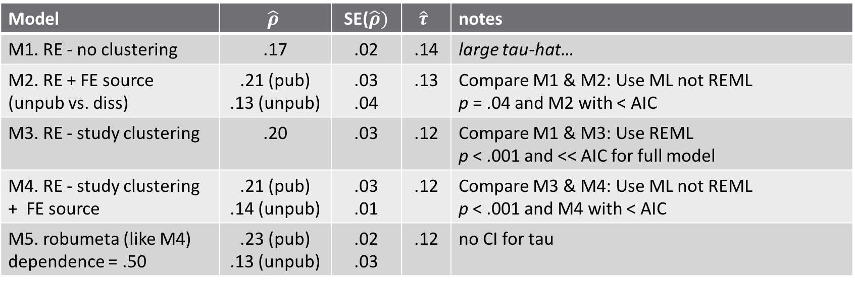
Ferguson & Brannick (2002) R output
M4
Model | $$\hat{ρ}$$ | SE($\hat{ρ})$ | $$\hat{τ}$$ | notes
M1. RE - no clustering | .17 | .02 | .14 | large tau-hat…
M2. RE + FE source (unpub vs. diss) | .21 (pub) .13 (unpub) | .03 .04 | .13 | Compare M1 & M2: Use ML not REML p = .04 and M2 with < AIC
M3. RE - study clustering | .20 | .03 | .12 | Compare M1 & M3: Use REML p < .001 and << AIC for full model
M4. RE - study clustering + FE source | .21 (pub) .14 (unpub) | .03 .01 | .12 | Compare M3 & M4: Use ML not REML p < .001 and M4 with < AIC
M5. robumeta (like M4) dependence = .50 | .23 (pub) .13 (unpub) | .02 .03 | .12 | no CI for tau

Slide 16
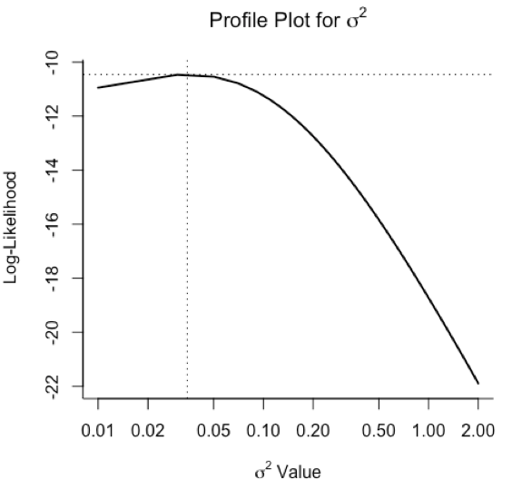

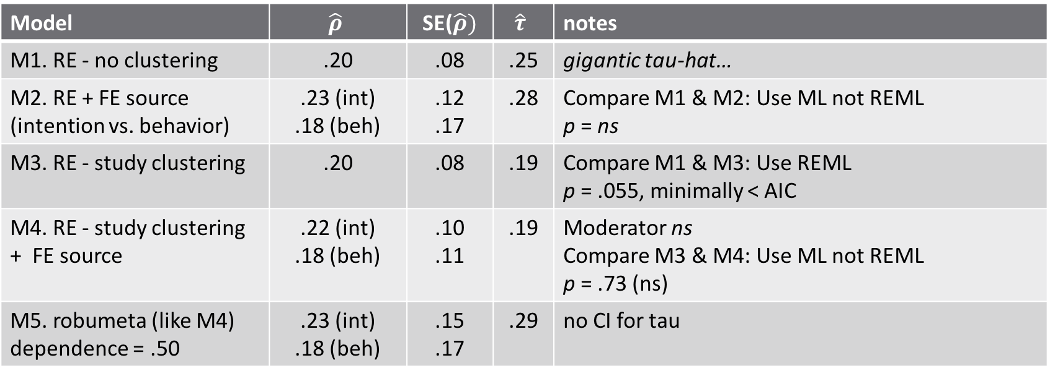
Sweeney (2015) R output
M4
Model | $$\hat{ρ}$$ | SE($\hat{ρ})$ | $$\hat{τ}$$ | notes
M1. RE - no clustering | .20 | .08 | .25 | gigantic tau-hat…
M2. RE + FE source (intention vs. behavior) | .23 (int) .18 (beh) | .12 .17 | .28 | Compare M1 & M2: Use ML not REML p = ns
M3. RE - study clustering | .20 | .08 | .19 | Compare M1 & M3: Use REML p = .055, minimally < AIC
M4. RE - study clustering + FE source | .22 (int) .18 (beh) | .10 .11 | .19 | Moderator ns Compare M3 & M4: Use ML not REML p = .73 (ns)
M5. robumeta (like M4) dependence = .50 | .23 (int) .18 (beh) | .15 .17 | .29 | no CI for tau

Slide 17
Conclusion
Two MA methods deal with the reality of messy dependence: robust meta-analysis (estimate dependence directy but not clustering) and multilevel modeling (estimate clustering directly but not dependence).
Being messy, these methods reach similar results from a practical perspective, given our examples.
In other words…

Slide 18
Conclusion
You can’t always get what you want.
You can’t always get what you want.
You can’t always get what you want.
But if you try sometimes, well you just might find
…you get what you need.

Slide 19
Thank you! (foswald@rice.edu) Modeling Dependent Effect Sizes in Meta-analysis: Comparing Two Approaches
Fred Oswald, Chen Zuo, & Evan S. Mulfinger Rice University

